Slide 1
CLOUD RESOURCE SHARING USING MULTI
FACTOR AUTHENTICATED KEY EXCHANGE
Domain :JAVA PROGRAMMING
A8 BATCH

Slide 3
AGENDA :
SOFTWARE REQUIREMENTS
HARDWARE REQUIREMENTS
MODULES
UML DIAGRAM
SCREEN SHOTS
CONCLUSION
ABSTRACT
INTRODUCTION
EXISTING SYSTEM
DISADVANTAGES
PROPOSED SYSTEM
ADVANTAGES

Slide 4
ABSTRACT :
Web based cloud is used to share the files using multifactor authentication by exchanging public keys.
Which has fast data processing with offline encryption and outsourced decryption.
Adaptable to any device for instance Web browsers, mobile and PC applications in our own wed based cloud for file storing , retrieving and safeguarding the data of user.
where we use different scheme such as CP-AB-KEM ,cryptographic algorithms are RSA-AES and mail secret key generation.

Slide 5
INTRODUCTON :
As we are concerned about user data security,we are providing security to the data in public cloud with low cost efficiency by encrypting data and storing it in cloud(DriveHQ).
The data is stored as encrypted data in cloud so,the data can’t be accesed by the unauthorised persons.
The data decrypted at user side while downloading,where for that it requires MAC address and security key.
security key is produced by PKG(public key generator) and sent to user via email,MAC is produced to user by reqesting it to the cloud service provider(csp).
user and file details are sent to the file owner.

Slide 6
End user:- Acesses the data which is uploaded by the data owner by requestin MAC and Secert key to CSPand PKG and decrypted file will be downloaded
Data owner:-uploads the encrypted file into the public cloud and manages the uploaded files
Cloud service provider:- It authorises the end user and data owner ,and produceses the MAC address to the user.
PKG:- Generates the secret key and forword to the user via email.

Slide 7
EXISTING SYSTEM :
Ciphertext-Policy Attribute-Based Encryption (CP-ABE) scheme is proposed, which achieves encryption and access control simultaneously
forget

Slide 8
DISADVANTAGES :
IR will be very difficult if large numbers of texts in a document.
Difficult to identify the important concepts or topic in a collection of documents.
The explicit rankings are always difficult to obtain or even not available in many documents

Slide 9
PROPOSED SYSTEM :
The proposed information retrieval system is very useful for finding out more relevant files for given keywords.
Anyone can easily identify the important documents in a collection of documents and retrieve the related data.
It proposes a PAC(passive aggressive classifier) which make easy for clustering the related documents based on that ranking.

Slide 10
ADVANTAGES :
We will build a IR system which gives the file of the most relevant files at the top of the search result based on the keyword , according to user queries.
The main focus of our system is to build a own search engine to discover the utmost suitable file for the given keyword by using machine learning techniques for increasing accuracy compared to available system.

Slide 11
SOFTWARE REQUIREMENTS :
OPERATING SYSTEM : Windows 7 Ultimate
CODING LANGUAGE : Python
FRONT END : Python
DESIGNING : Html , CSS , Java script
DATABASE : MySQL

Slide 12
HARDWARE REQUIREMENTS :
SYSTEM : Pentium IV 2.4 GHz
HARDDISK : 40 GB
FLOPPY DRIVE : 1.44 Mb
MONITOR : 14’Color Monitor
RAM : 512 Mb

Slide 13
MODULES :
MANAGER : Uploads the file.
USER : Access the file.
ADMIN : Give authority to managers and users .
MACHINE LEARNING : Makes decisions by analyzing existing data.

Slide 14
UML DIAGRAMS :
Use case Diagram
Class Diagram
Sequence Diagram
Activity Diagram

Slide 15
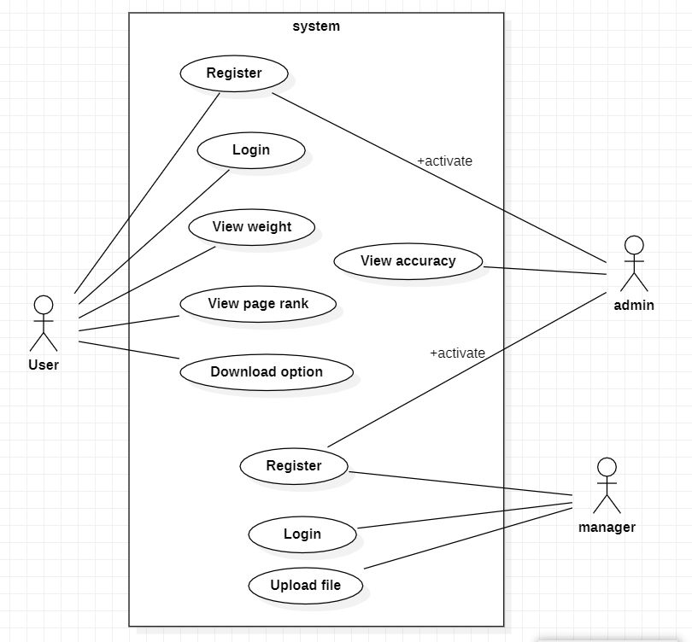
USECASE DIAGRAM :

Slide 16
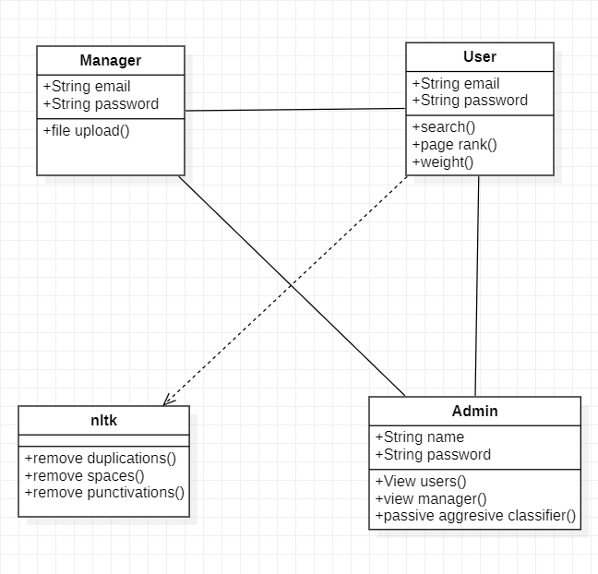
CLASS DIAGRAM :

Slide 17
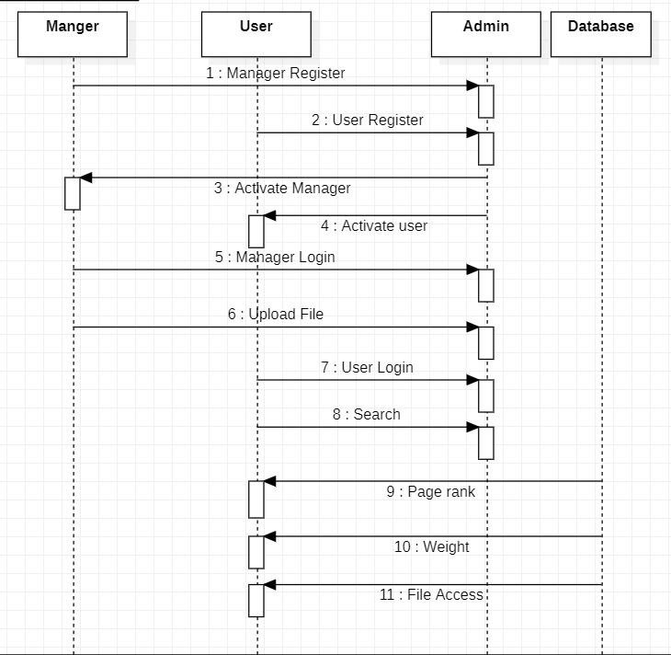
SEQUENCE DIAGRAM :

Slide 18
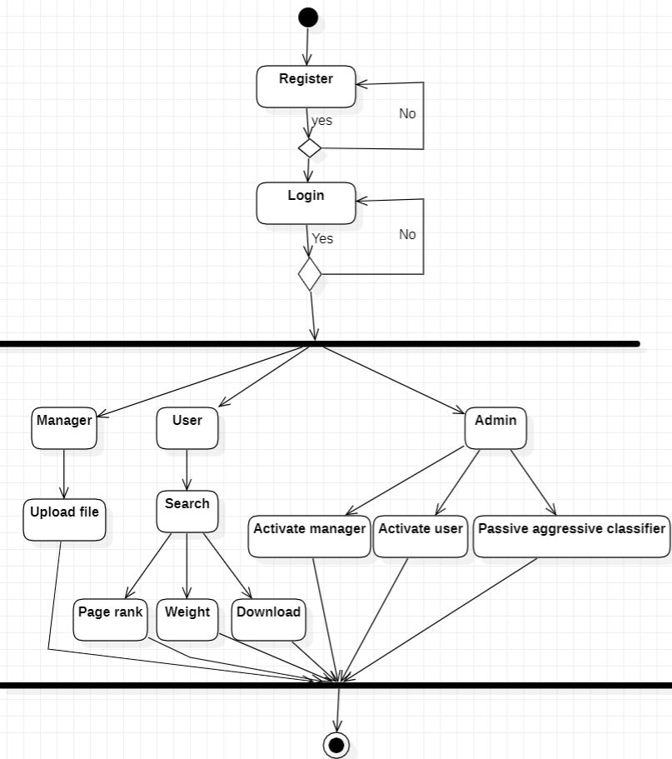
ACTIVITY DIAGRAM :

Slide 19
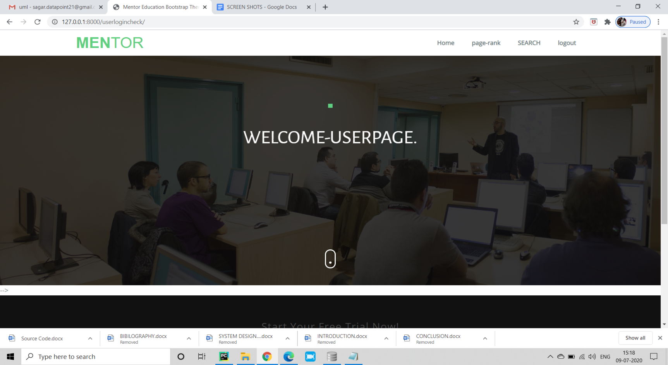
SCREENSHOTS :
User home page :

Slide 20
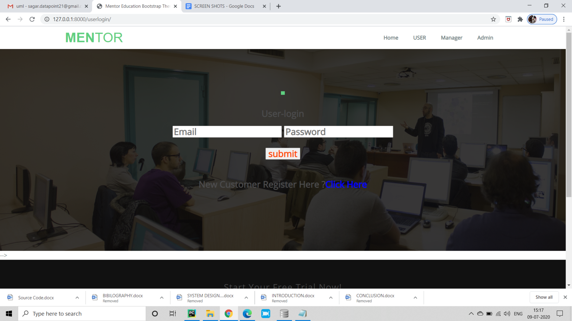
User login page :

Slide 21

Manager home page :

Slide 22
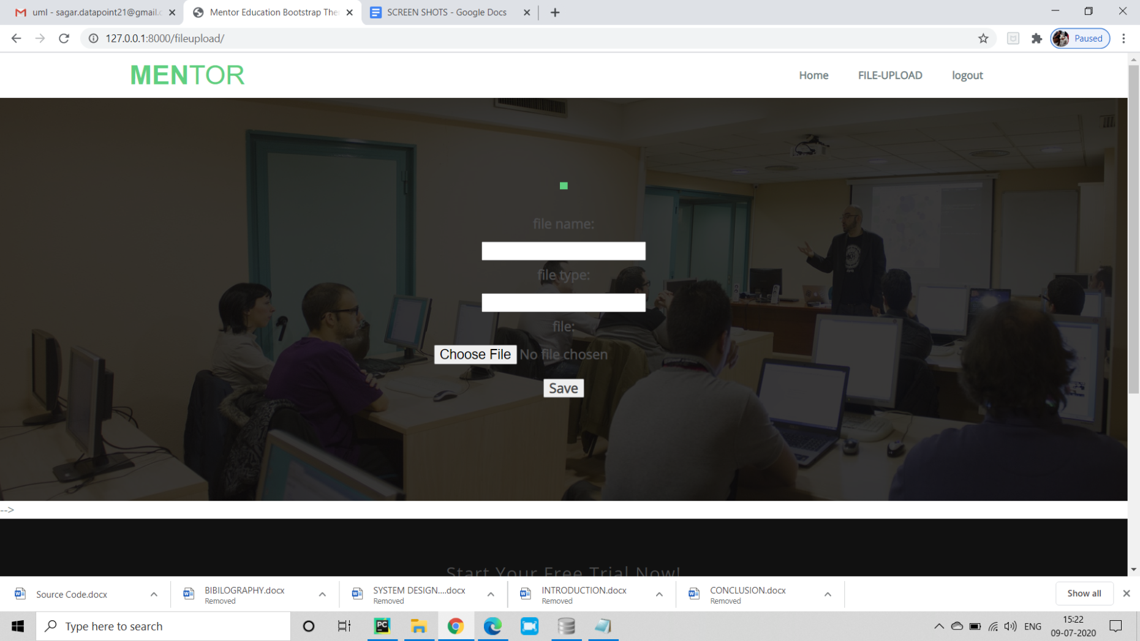
Manager file upload page :

Slide 23
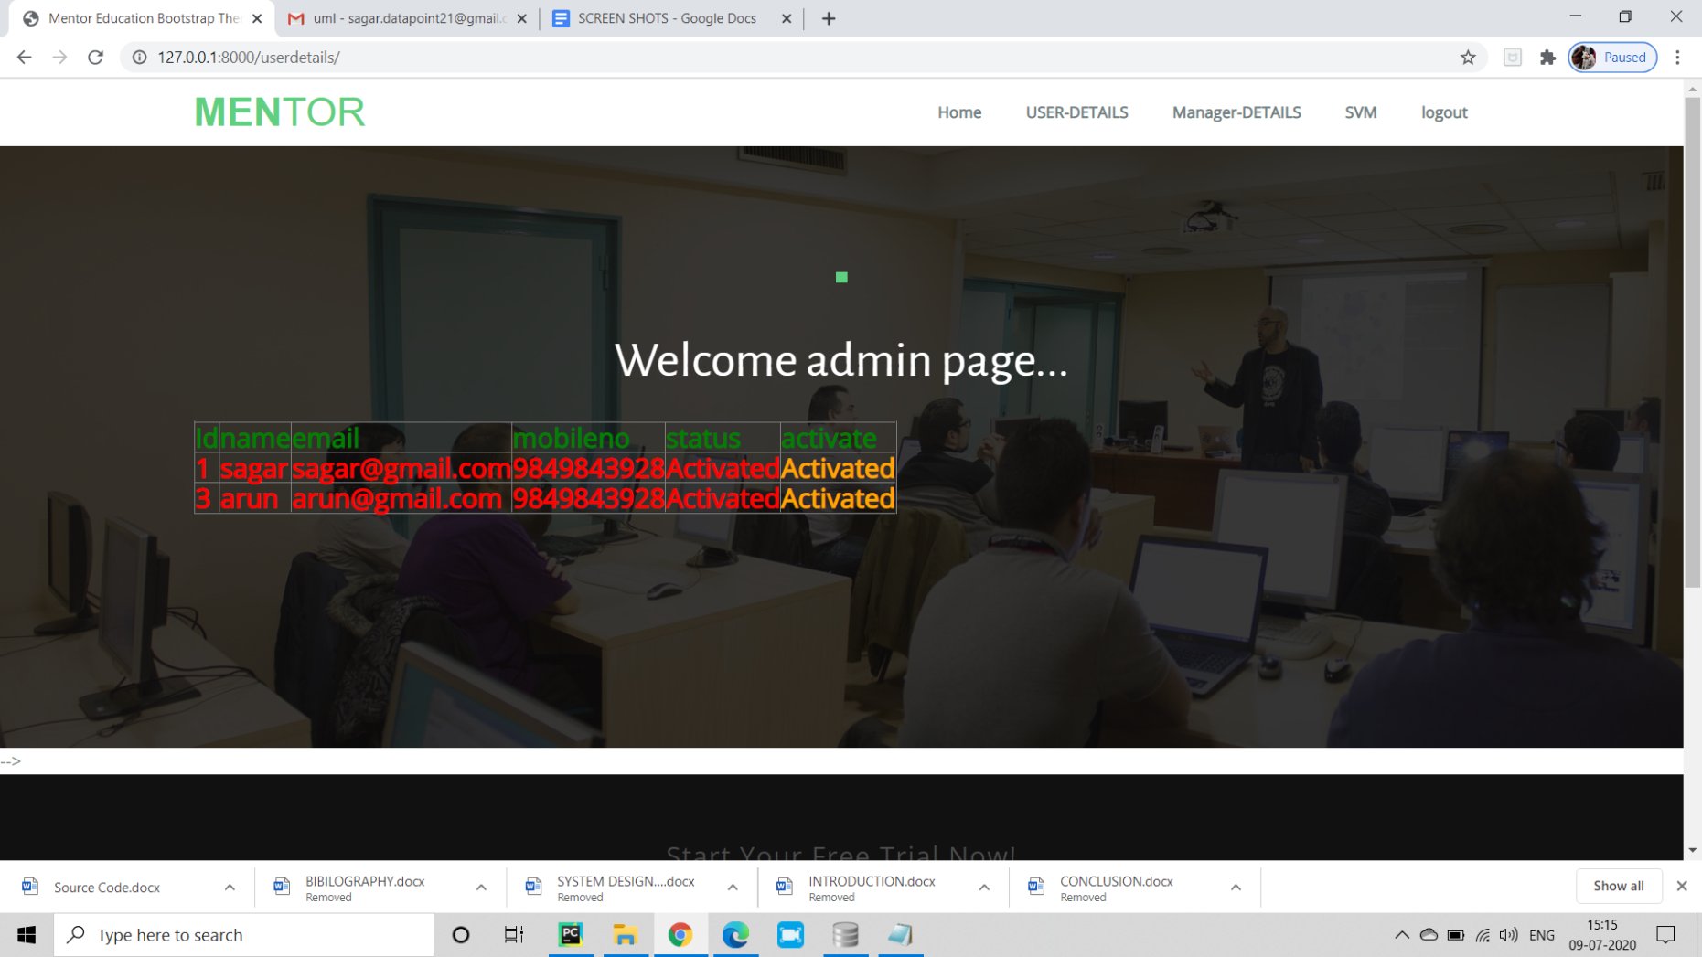
User details :

Slide 24
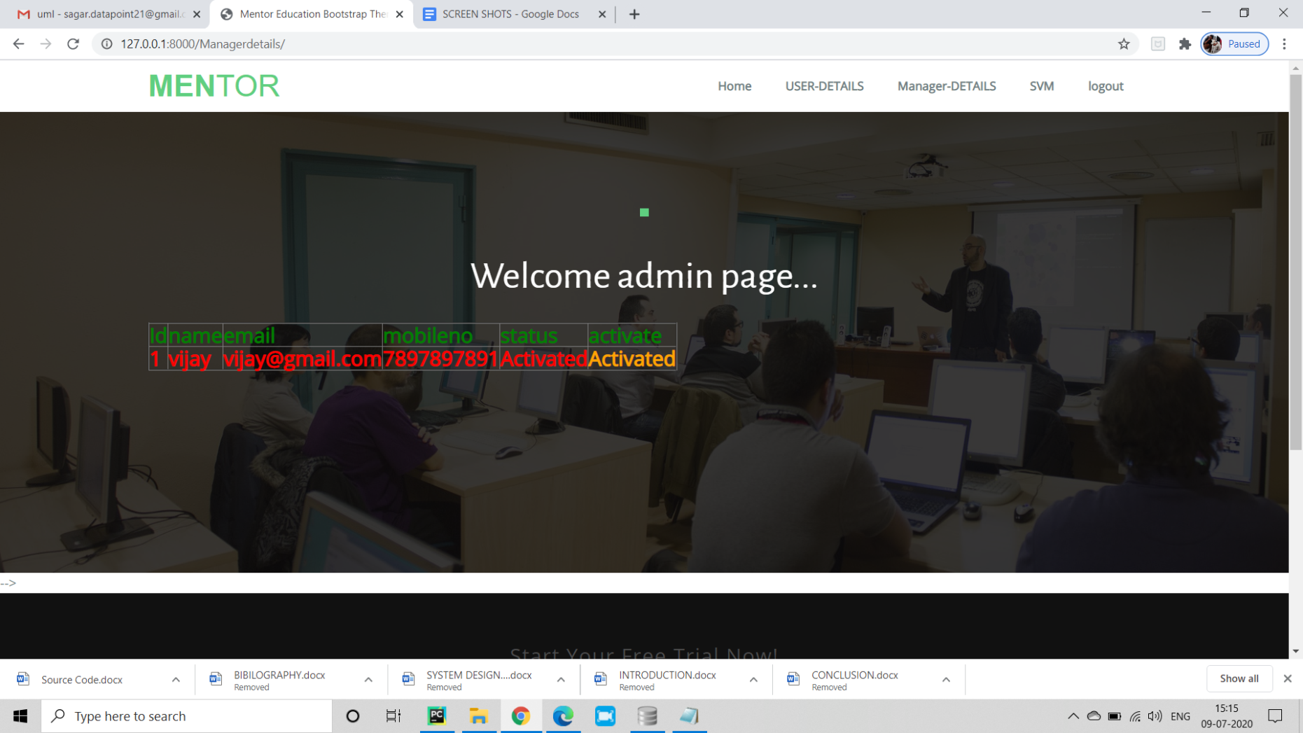
Manager details :

Slide 25
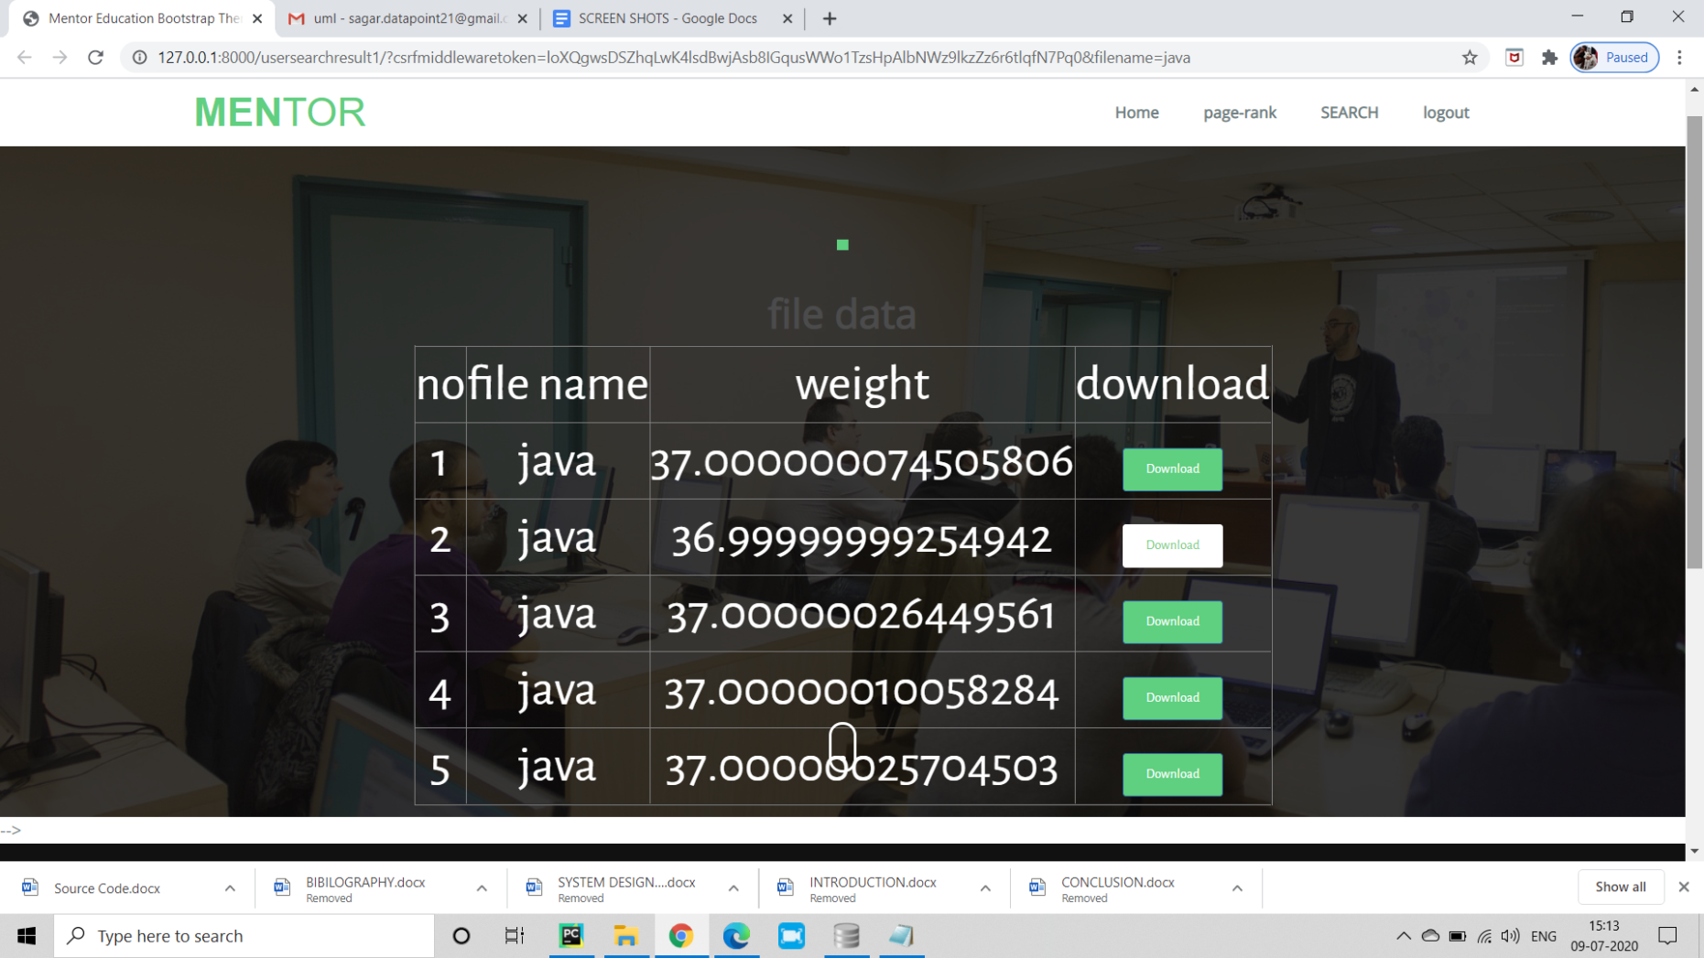
File access to user :

Slide 26
CONCLUSION :
Information Retrieval is very useful for finding out more relevant files for given keywords.
User time is reduced for searching the relevant files from folders.
For this, Accuracy is a very important factor.
Passive aggressive Classifier and PageRank algorithms will give better accuracy than SVM .

Slide 27
THANK YOU
THANK YOU

